Slide 1
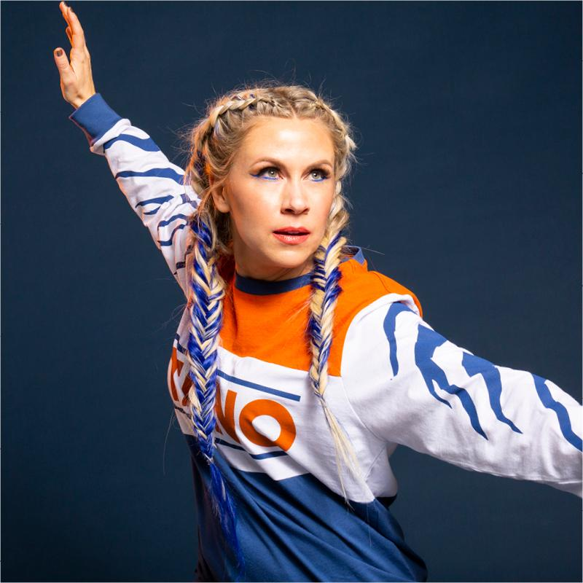
Ashley Eckstein

Slide 2
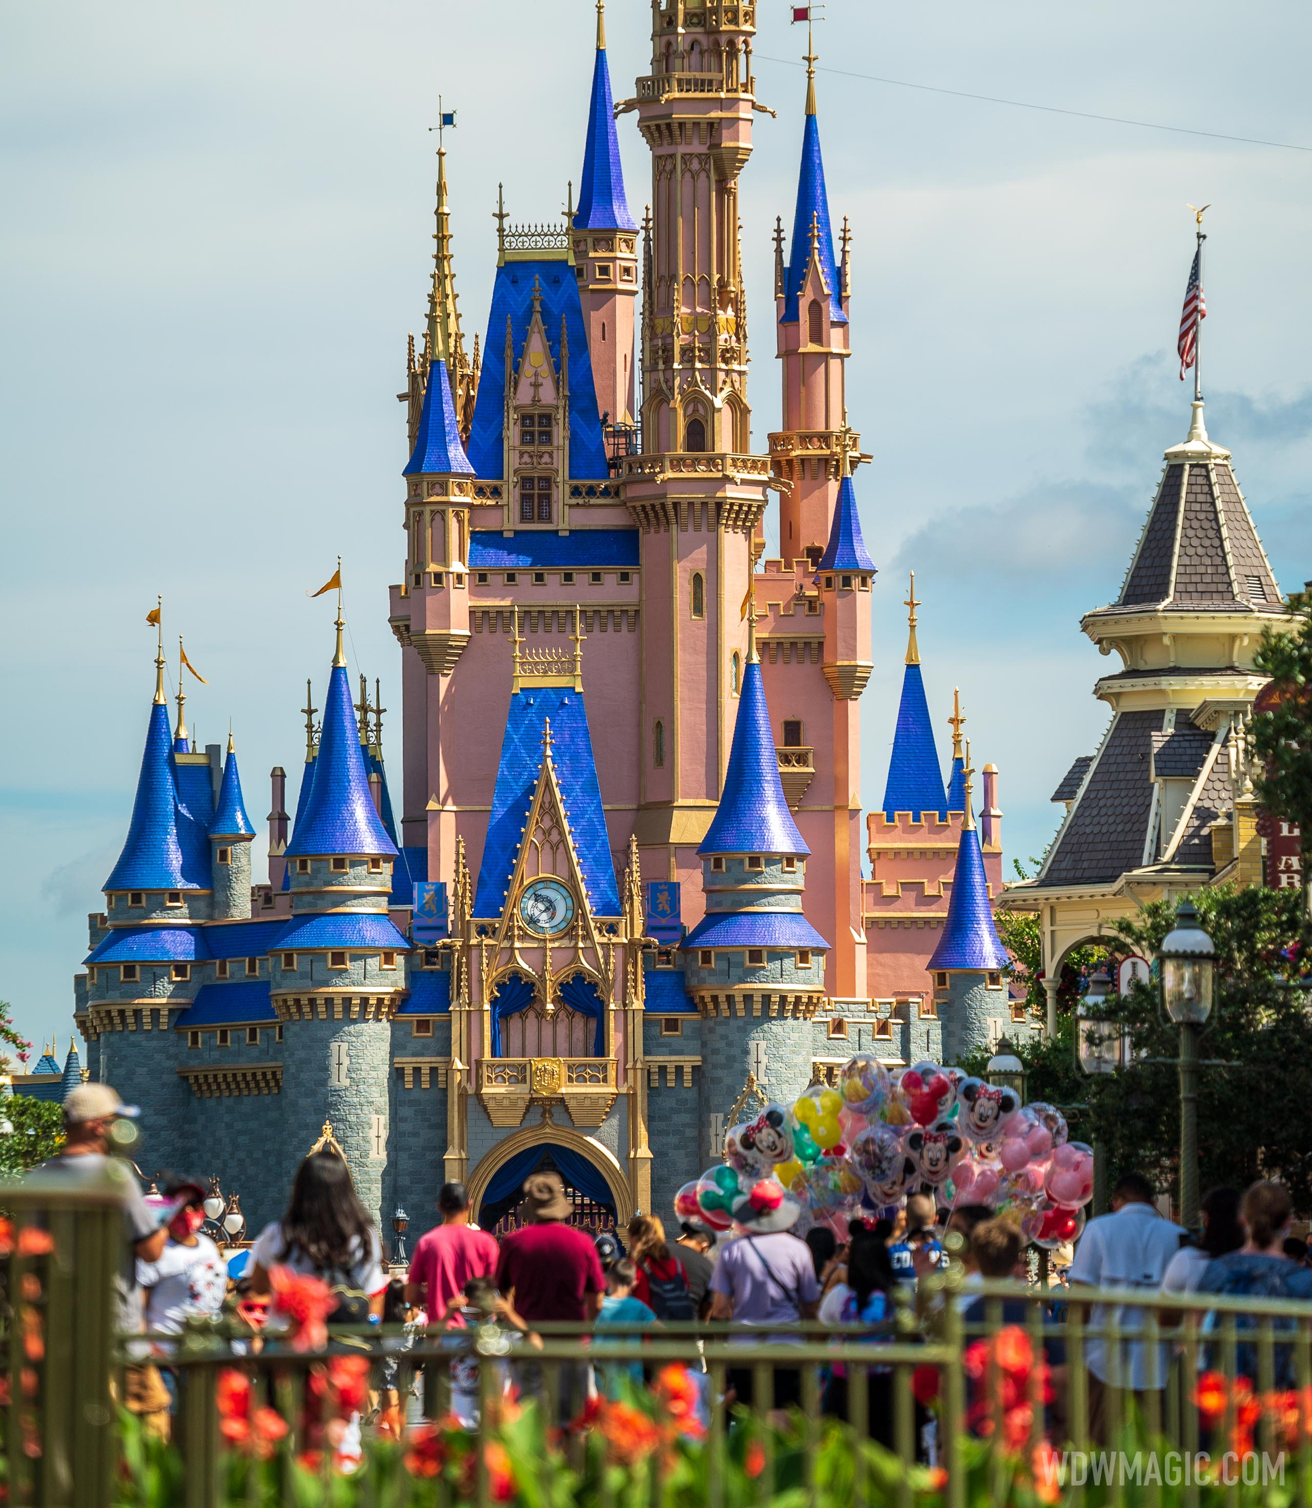
“I grew up Disney”
-Ashley Eckstein, “It’s Your Universe”
Ashley Eckstein was born in 1981 and grew up in Orlando Florida.
Her parents worked at Disney World and she got to visit the park with her family all the time.
When she was 16 she started working at Disney World too and even got to perform in some of the parades.
Photo Credit: Cinderella’s Castle – www.wdwmagic.com/attractions/Cinderella-castle/gallery

Slide 3
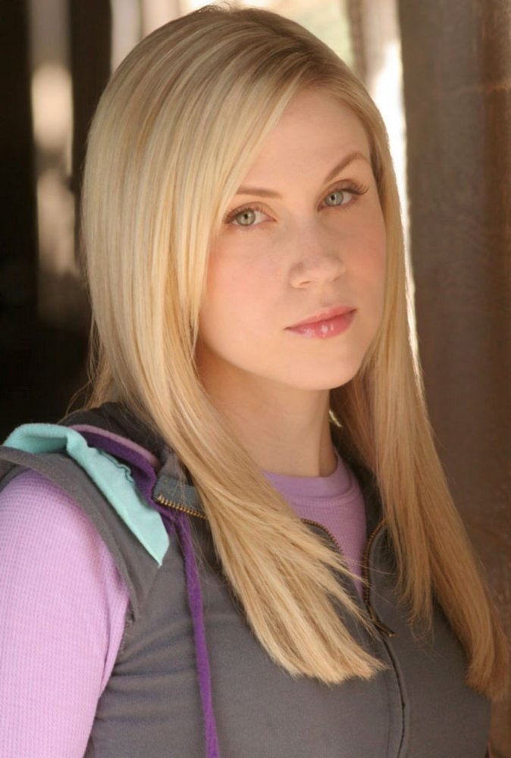
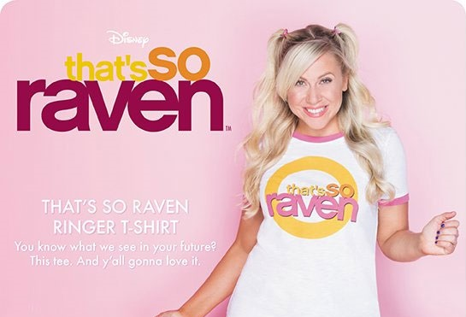
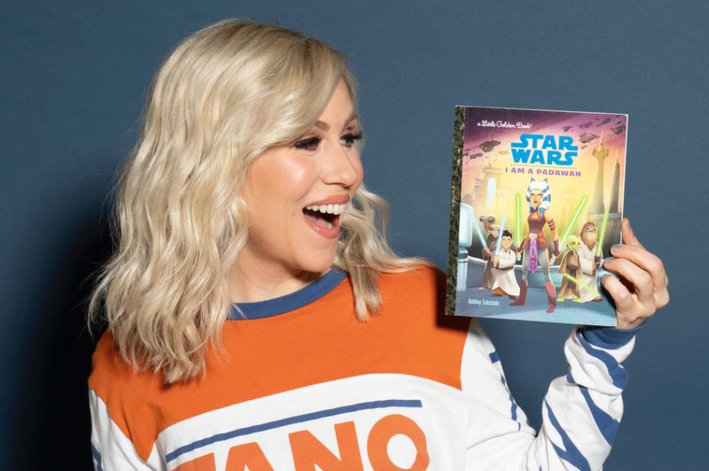
“Dream it. Do it.”
- Ashley Eckstein
“As a kid, I loved the Disney Channel, and I always dreamed of being on it myself” -Ashley Eckstein, “It’s Your Universe”
So, at age 18 she moved to L. A. by herself to live that dream.
After a few short gigs and a lot of rejection, she became the recurring character, Muffy, on “That’s So Raven.”
Then she got the acting break that would change her life. She was cast as one of the leading characters, Ahsoka Tano, for “Star Wars the Clone Wars”.
Photo Credit: Her Universe – blog.heruniverse.com
Photo Credit: Ashley Eckstein – “It’s Your Universe”
Photo Credit: Lyra Hale – www.fangirlish.com

Slide 4
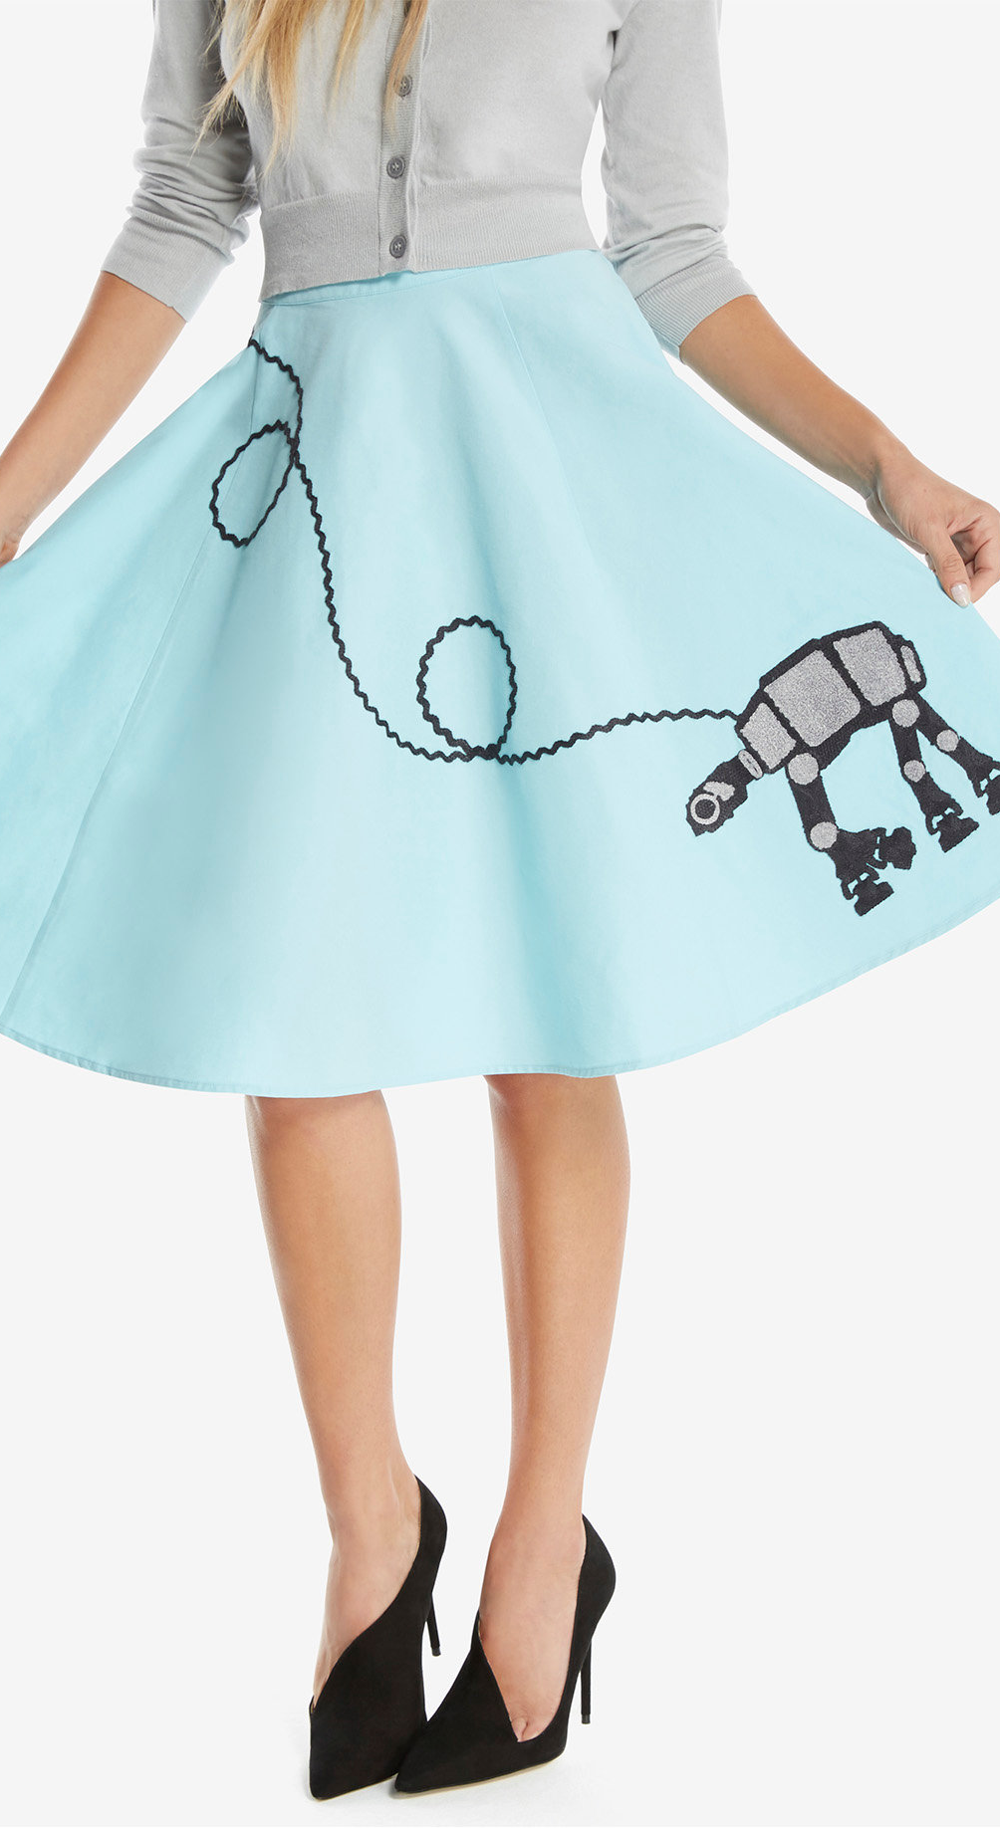
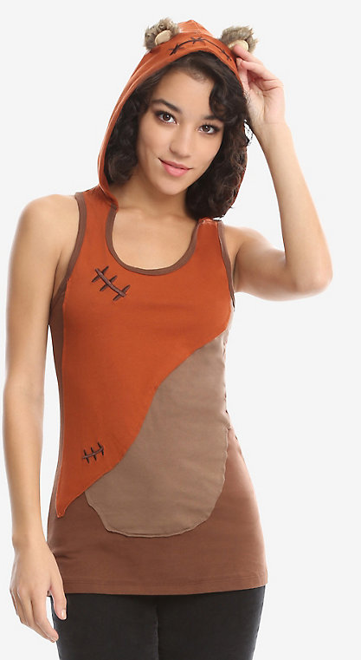
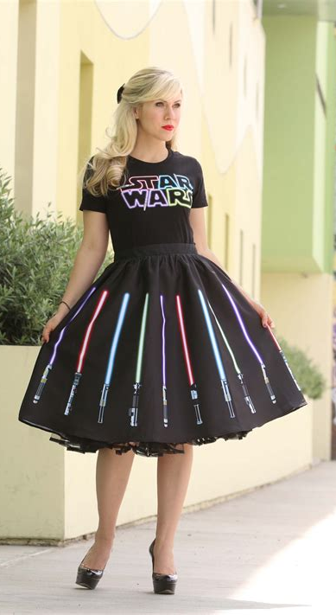
“Now that I was the voice of Ahsoka Tano, my life was immersed in the Star Wars universe…I wanted to show off my Star Wars fandom with my attire.”
Now that Ashley Eckstein was travelling to Star Wars conventions all the time, she wanted something themed to wear.
When she discovered that no one made Star Wars clothing for women and girls, she decided to do something about it.
On June 22, 2010, Ashley founded “Her Universe” and using her influence with Lucasfilm as an actress, she was able to get a license to sell Star Wars merchandise.
-Ashley Eckstien, “It’s Your Universe”
Photo Credit: Her Universe – www.heruniverse.com

Slide 5
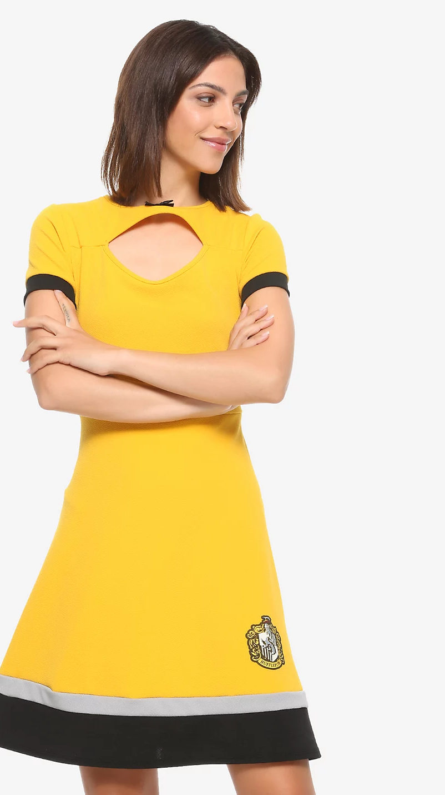
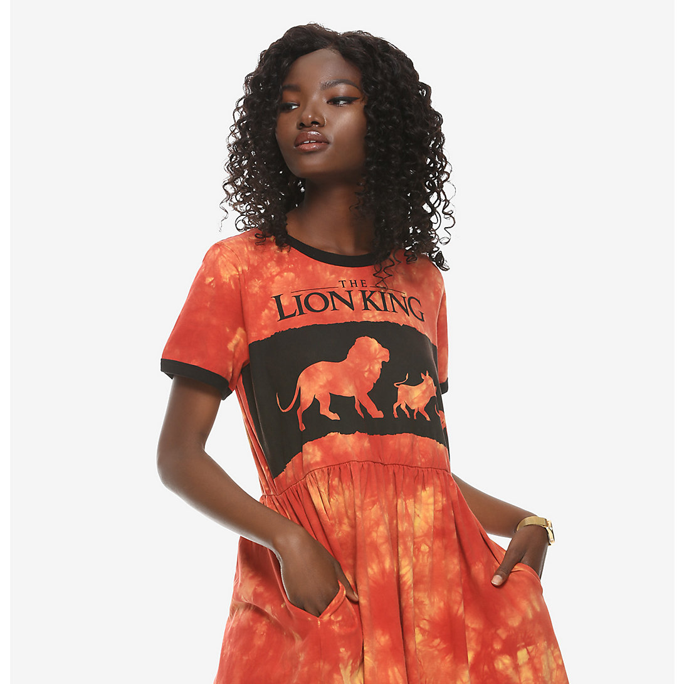
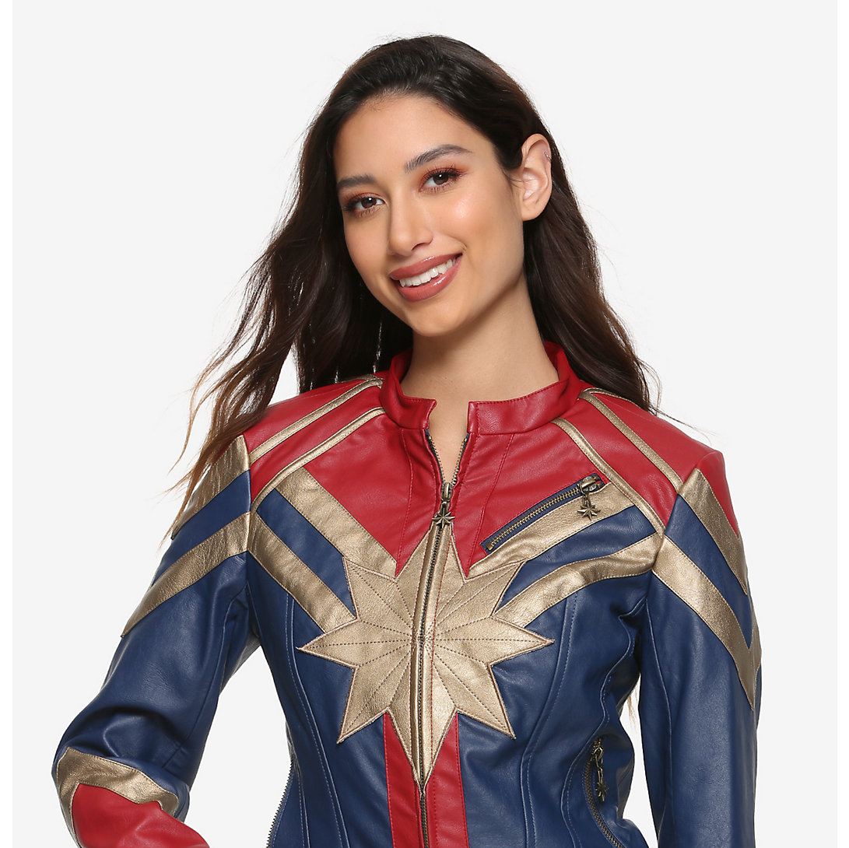
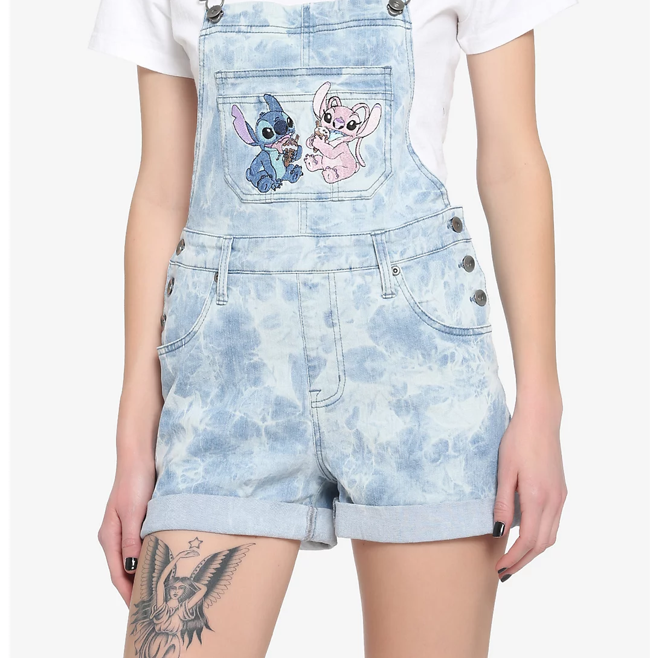
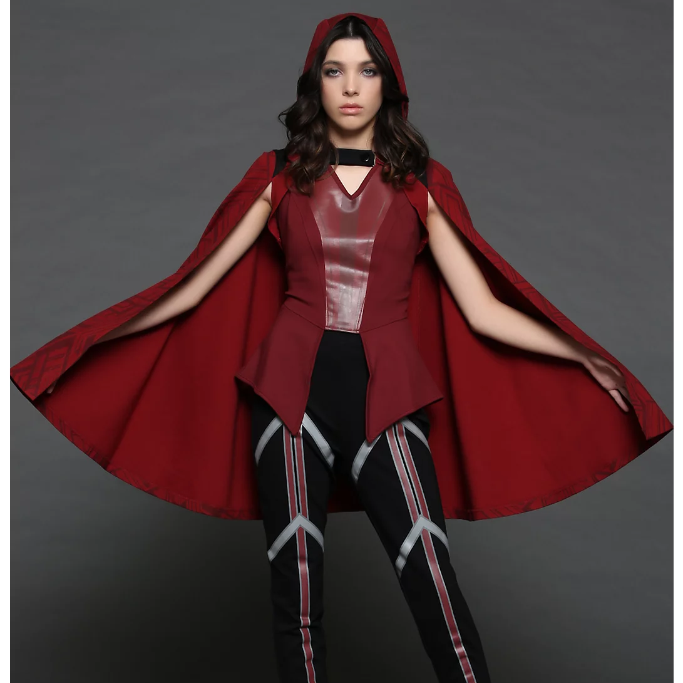
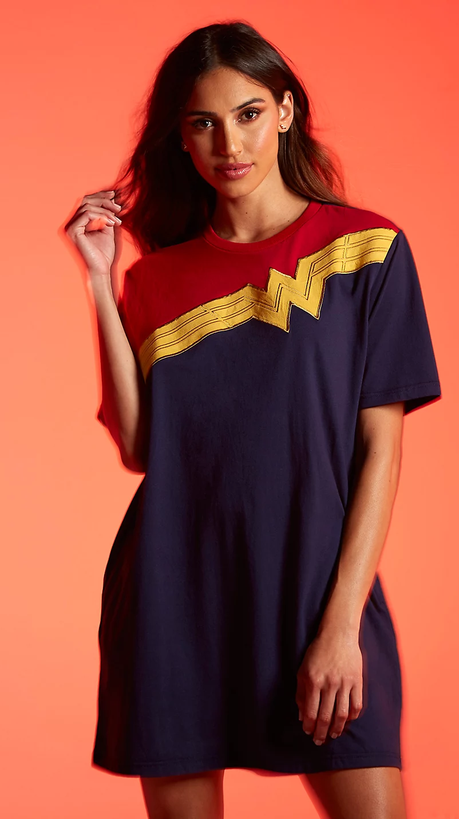
Though Her Universe started with just the Star Wars fandom, it grew out to incorporate many, many other fanbases! Some of these include Marvel, Harry Potter, D.C., Disney, Avatar the Last Airbender, etc.
Photo Credit: Her Universe – www.heruniverse.com

Slide 6
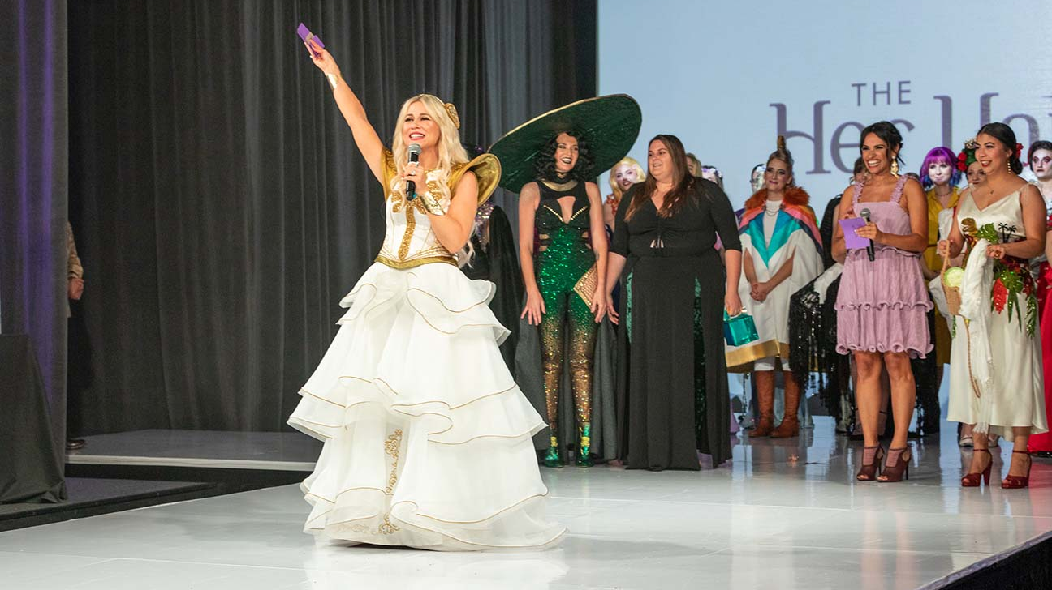
“Her Universe is a merchandise line,
but more importantly it is a community”
- Ashley Eckstein
Ashley Eckstein wanted Her Universe to be a community. She not only started the company so women would have something to wear to show their fandoms, but also to stop the bullying that girls were facing for liking things like Star Wars. Her Universe started having a “Fangirl of the Day” which was a social media shoutout to a different fangirl every day, showing that none of them were alone.
Ashley also started an annual fashion show at the San Diego Comic Con where fans could submit their designs and 20 would be selected to participate in the fashion show. The prize would be a spot in designing the next line for Her Universe!
Photo Credit: Her Universe- www.heruniverse.com

Slide 7
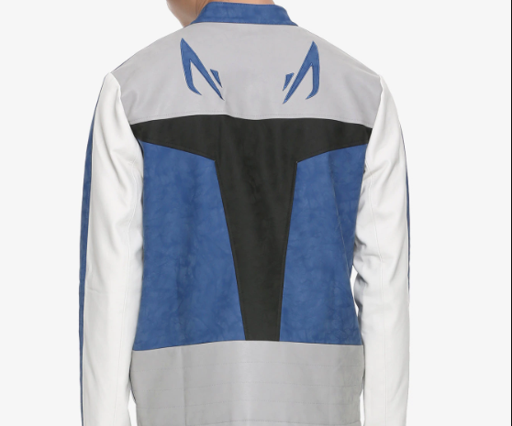
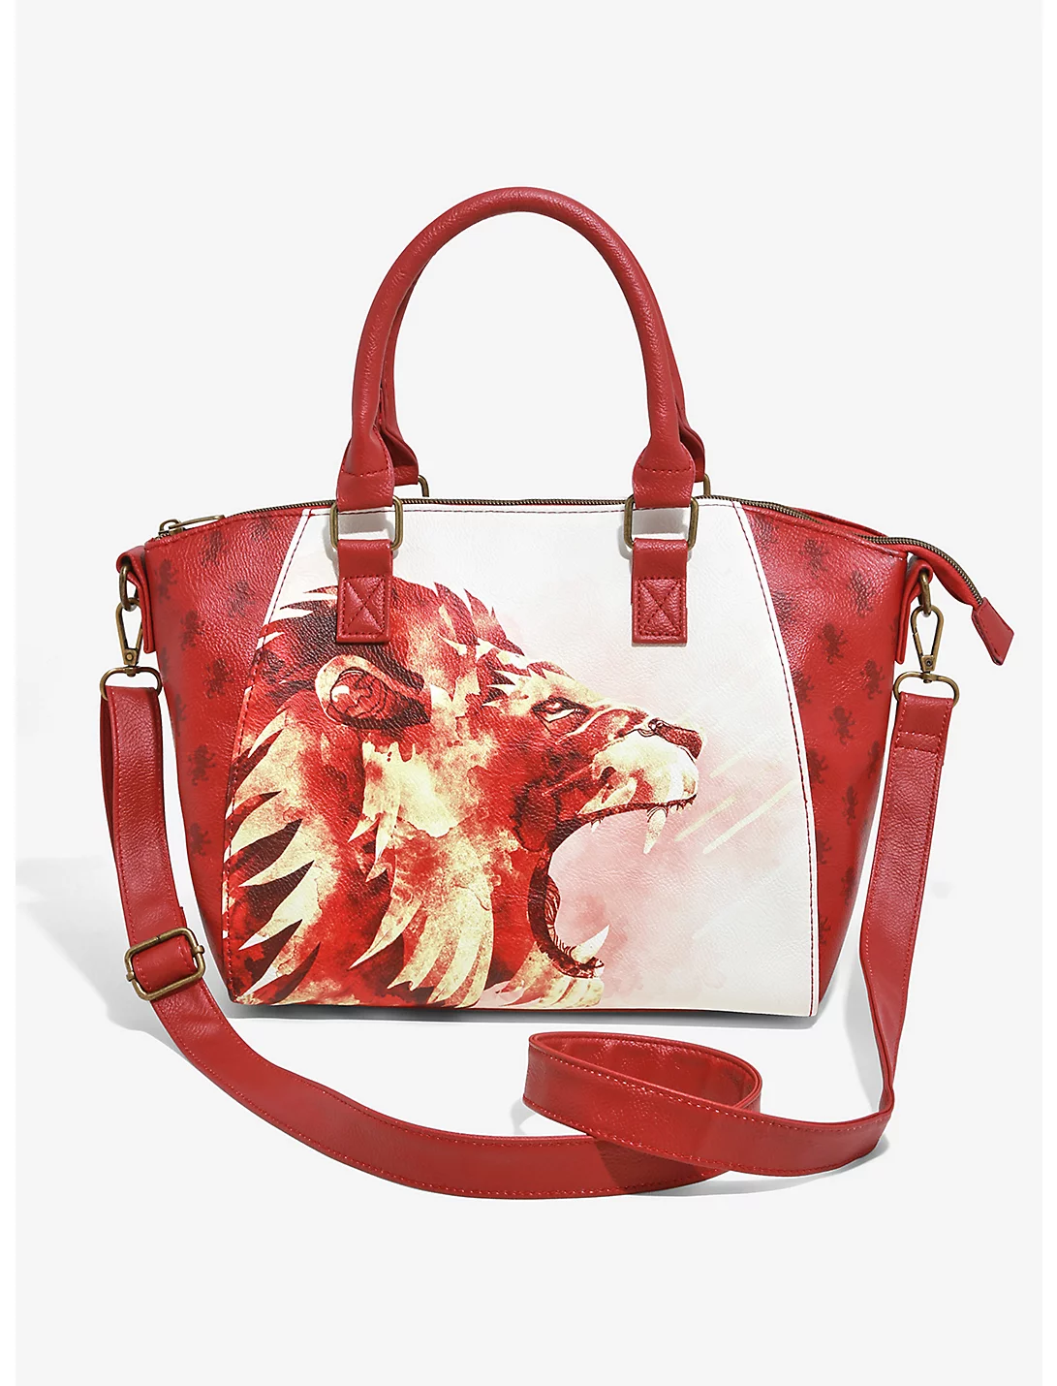
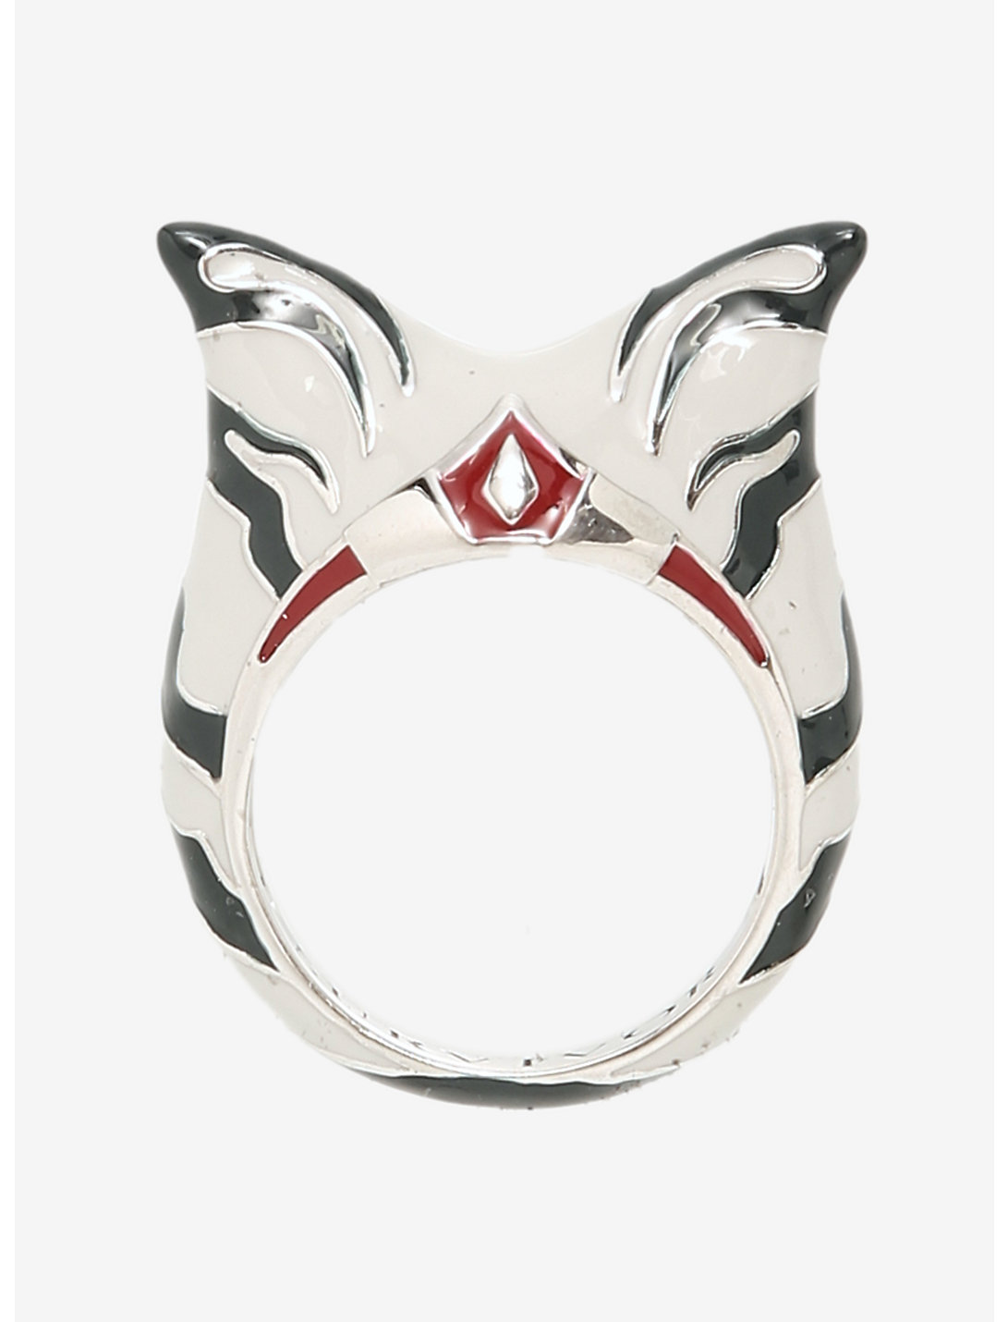
In October 2016, Her Universe became part of the Hot Topic family of brands. This opened opportunities for them to continue growing and to collaborate with other companies.
Her Universe created another branch called Our Universe that also dealt with Men’s wear. Her Universe also collaborated with businesses like Loungefly and RockLove to produce items such as handbags and jewelry.
Photo Credit: Her Universe – www.heruniverse.com

Slide 8
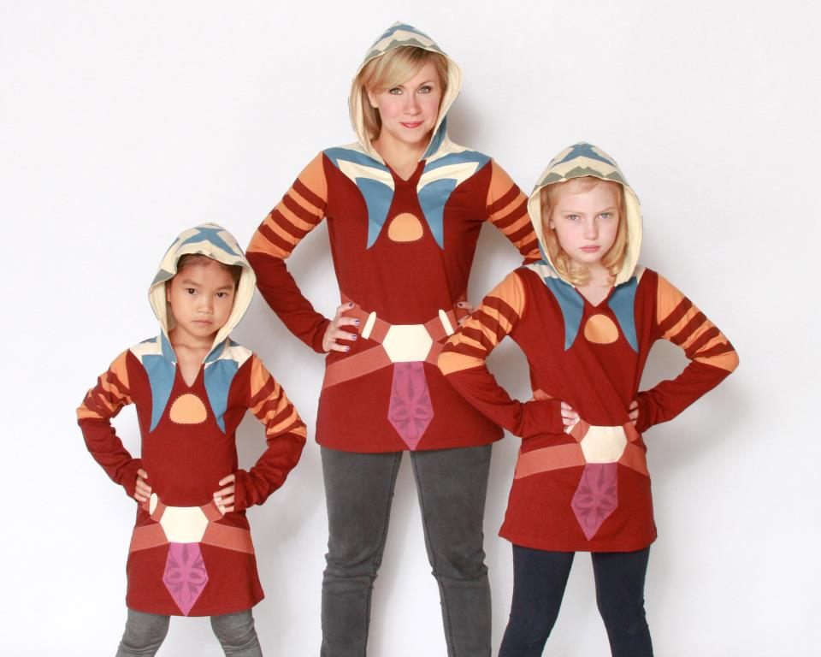
How did these designs effect the lifestyles of the consumers? Her Universe allows women and girls to show their love of these franchises and to be a part of the fandom community!
“My WHY was the fangirl community. My WHY was a different girl I met each and every day.”
Ashley wanted to make Her Universe a community that encouraged female fans to love the things they love. She wanted to stand up for the young girls who were being bullied and give them a space to be themselves.
-Ashley Eckstein, “It’s Your Universe”
Photo Credit: Star Wars Weekends – www.zannaland.com

Slide 9
Bibliography
Eckstein, Ashley, and Stacy Kravetz. It's Your Universe: You Have the Power to Make It Happen. Disney Editions, 2018.
Rossi, Tony. “Ashley Eckstein, The Voice of Star Wars' Ahsoka Tano, Is a Force for Good for Those with Mental Health Issues.” Light One Candle - the Blog of The Christophers, 22 Apr. 2020, https://thechristophersblog.org/2020/04/22/ashley-eckstein-the- voice-of-star-wars-ahsoka-tano-is-a-force-for-good-for-those-with-mental-health- issues/.

