Slide 1
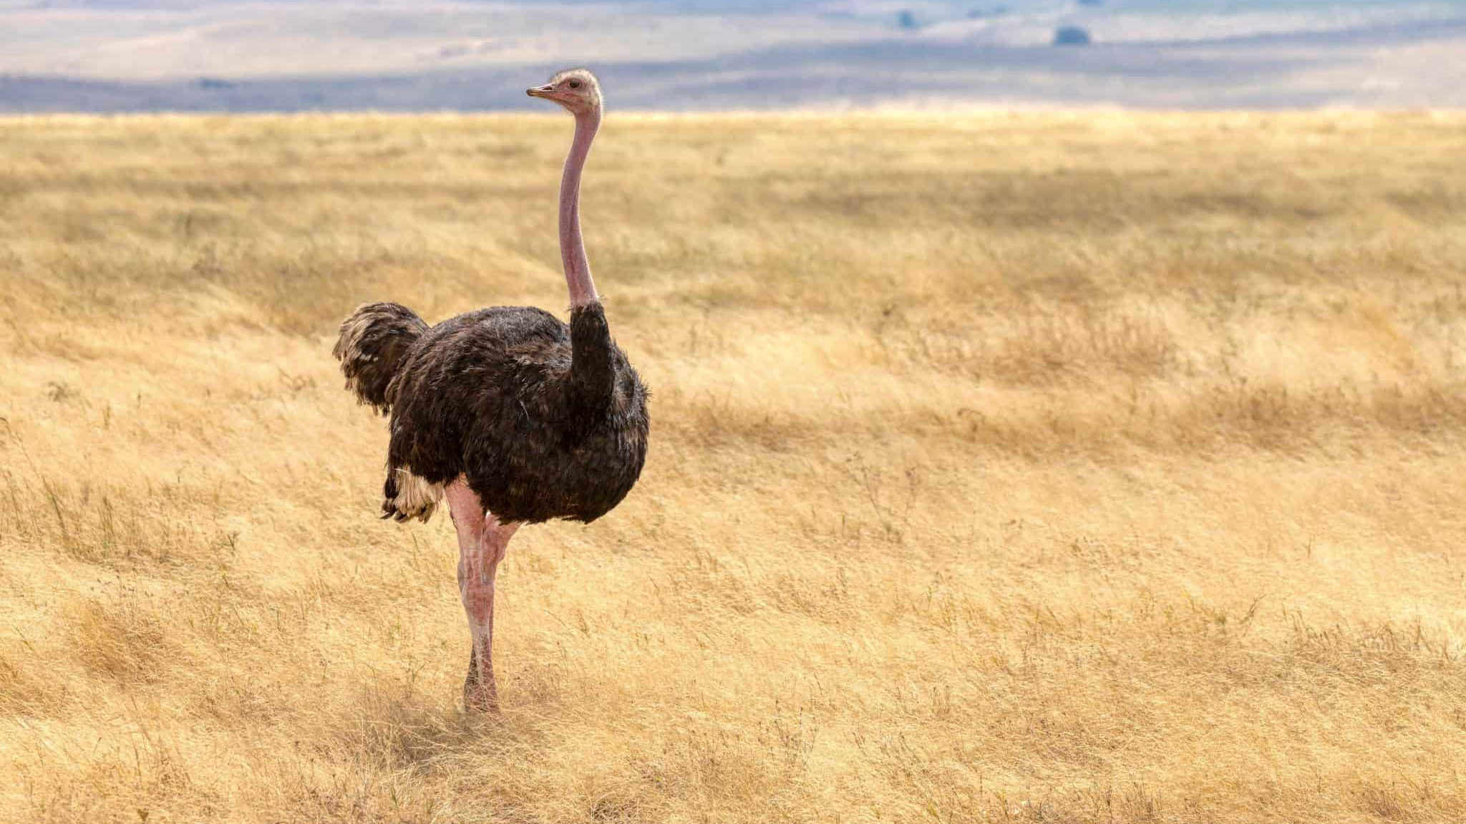
Ostrich Textiles
By Charity S. L. Bryan
FACS 320-001

Slide 2
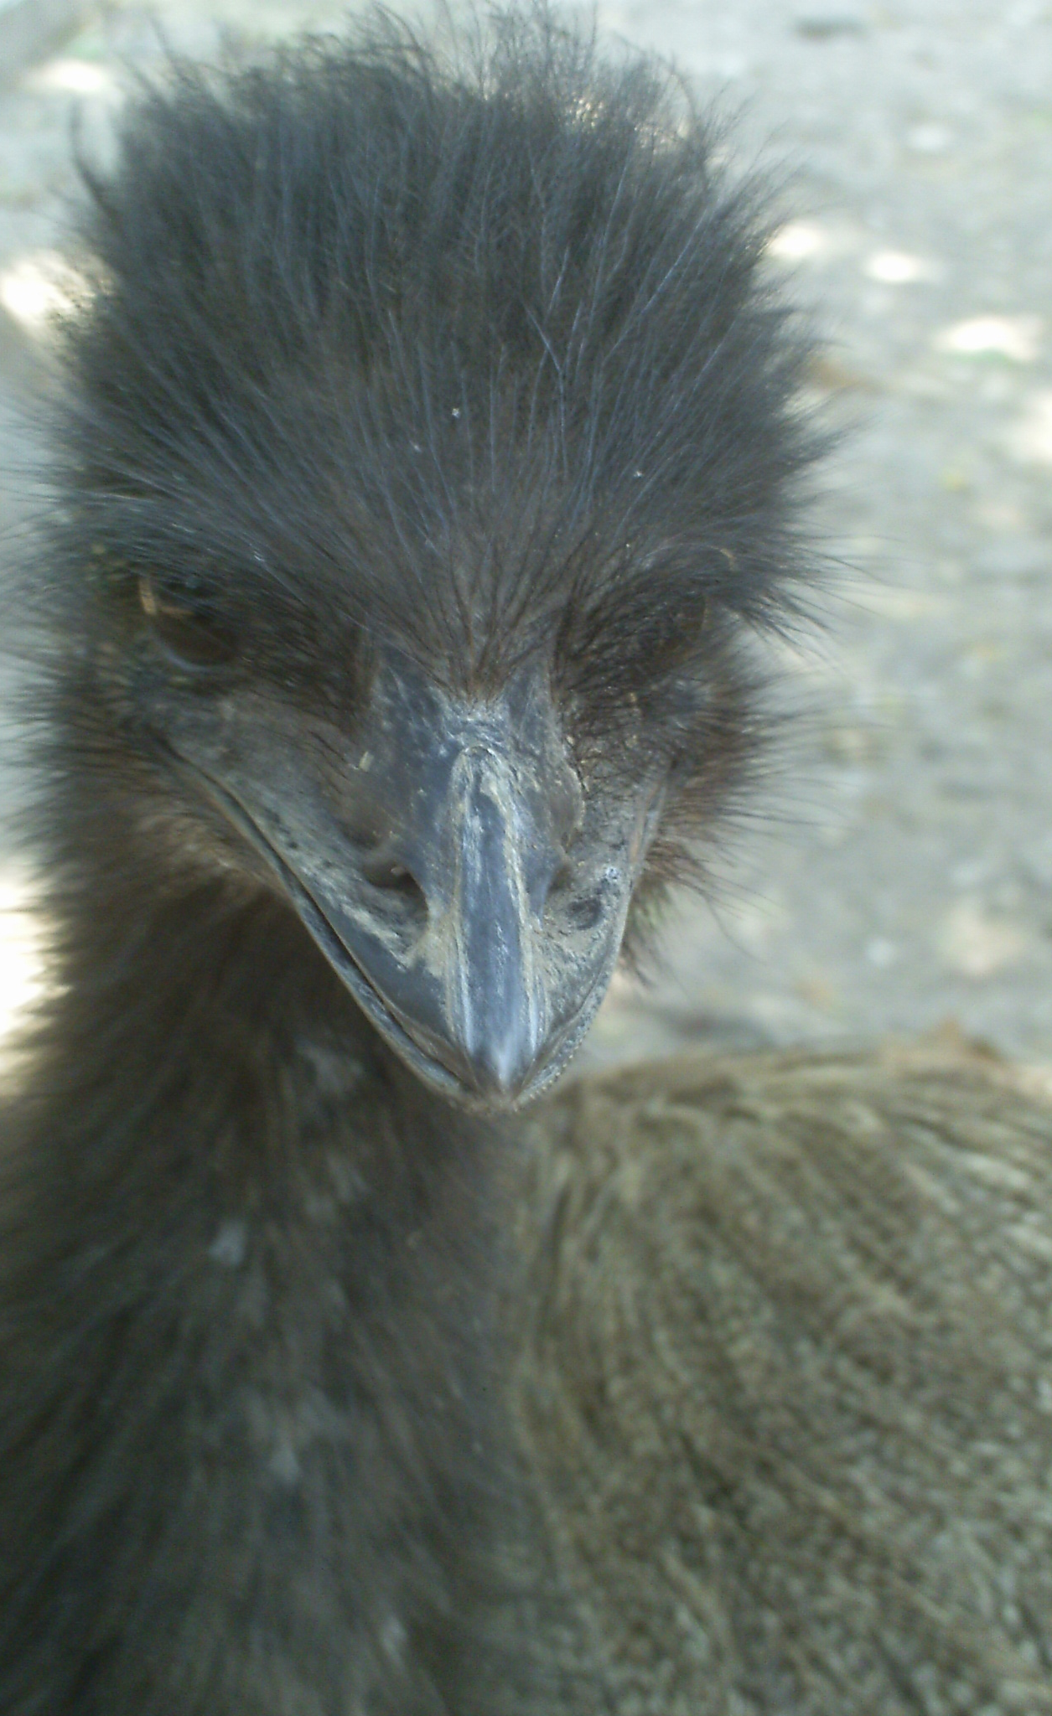
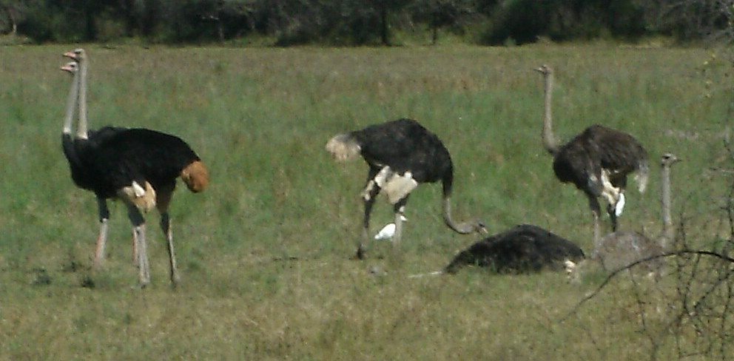
Why Ostriches?
I spent a little over six years of my childhood in Botswana, Africa, and I loved going on safaris and seeing the wild animals. Especially ostriches.
When I was in middle school I did some puppetry for kids at VBS. My puppet was an ostrich named “Lola”.

Slide 3
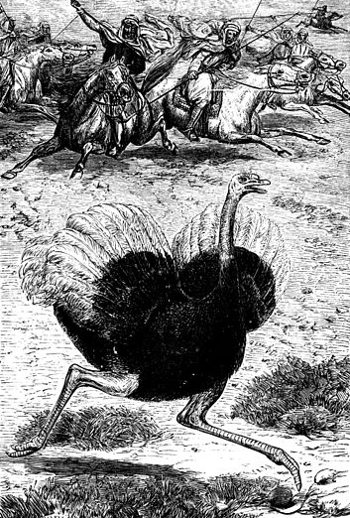
History of Ostrich Farming
Ostrich feathers have been used in fashion for almost as long as we can go back. They have always been considered quite extravagant and often signified status.
Wild ostriches were hunted for their feathers until 1860 when the first ostrich farm was created in South Africa. Farms did not exist prior to this because they did not have the proper equipment to take care of the ostrich eggs.
When the ostrich market crashed due to the world wars, ostrich farmers needed to expand beyond feathers in order to keep their businesses alive. They began to sell ostrich leather and meat.
South Africa owned a total ostrich monopoly until 1993 when the demand for ostrich leather became more than they could produce alone. The end of apartheid also played a large part in the breaking of the monopoly.

Slide 4
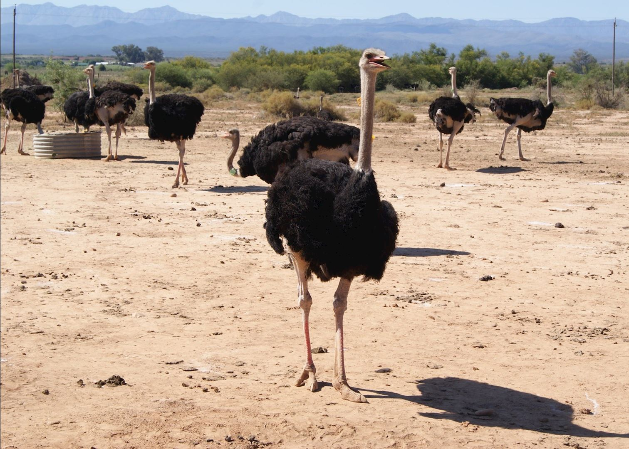
African Ostrich Farming
South Africa is still the number one ostrich goods export in the world. The desert habitat makes it ideal for raising the birds.
90% of goods come from the “ostrich capital”, Oudtshroon.
Ostrich farms in Africa also get a lot of their revenue from tourists who visit the farms.
Other notable ostrich farming countries in Africa are Botswana and Zambia.

Slide 5
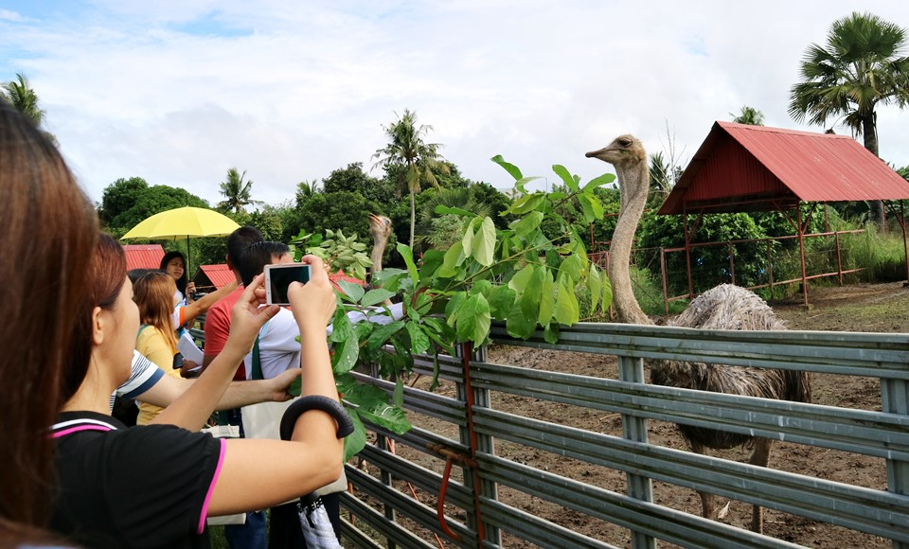
Asian Ostrich Farming
When South Africa allowed other countries to have ostrich farms, China quickly became the second biggest export.
China developed more advanced technology that could process food for the ostrich faster than ever before.
They also developed better technology for ostrich egg incubators.

Slide 6
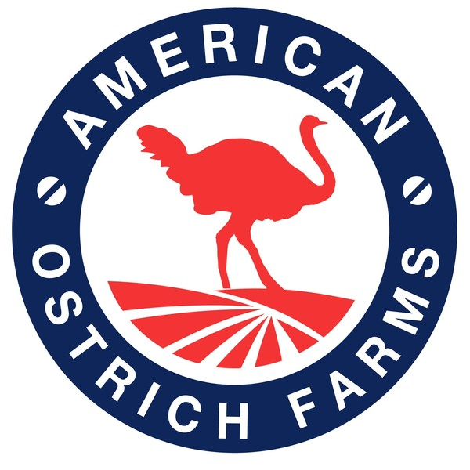
American Ostrich Farming
America is also a large producer of ostrich goods. Most ostrich farms are located in Idaho and Texas.
The American Ostrich Association helps small farmers get started and make their way in the industry.
American ostrich farms are best known for their export of leather goods, especially ostrich leather boots.

Slide 7
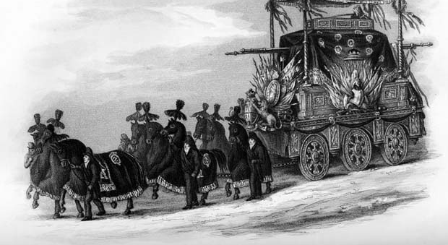
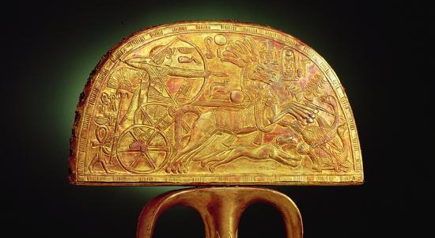
Ostrich Feathers have always intrigued people. They have been used as a sense of status for centuries.
Egyptian kings used to hunt the birds. When King Tutankhamun’s tomb was opened, an ostrich fan was found. Though the feathers had long since deteriorated, the story of the hunt was still etched into the gold plate.
In the Victorian era, wealthy Englishmen funerals would be adorned with ostrich feathers. The horses pulling the hearses would have ostrich feather caps to show the status of the deceased.

Slide 8
Ostrich feathers are still considered to be a luxury item. They are mainly worn by celebrities and wealthy people.
The famous actress, Rihanna, is particularly known for her ostrich feather fashions.

Slide 9
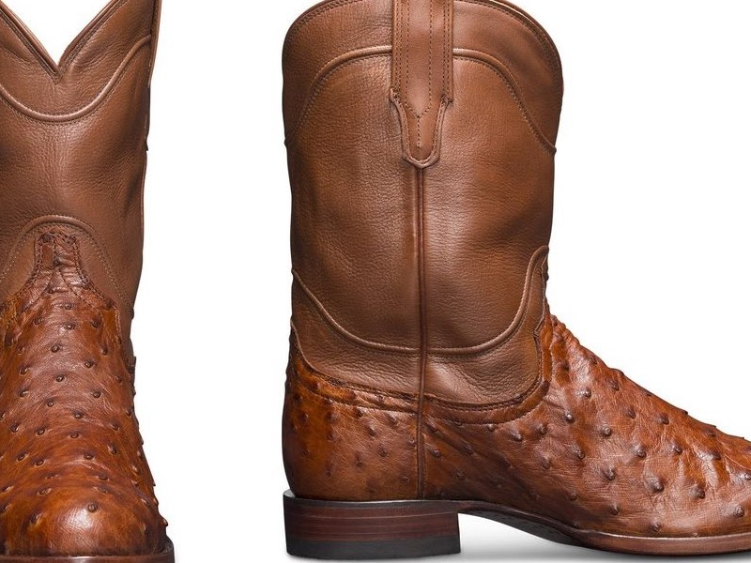
Ostrich Leathers
When the ostrich market crashed, ostrich leather was introduced.
Ostrich leather is popular in items such as boots, handbags, and belts.
Designers are especially found of creating matching accessories out of ostrich leather.

Slide 10
References
American Exotics, 2014, “Alligator and Ostrich Skin – Intricate Tanning Processes”, Exotic Leather for Luxury Production Artists, Alligator and Ostrich Skin Intricate Tanning Processes | Exotic Skin (archive.org)
American Ostrich Association, 2022, About us (ostriches.org)
Chester, Jason, 2015, “Naomi Watts Dazzles in Plunging Feathered Gown as She Sweeps Across the Red Carpet at Cannes Opening Ceremony”, Daily Mail, Naomi Watts sweeps across the red carpet at Cannes opening ceremony | Daily Mail Online
Lee, Alexander, 2021, “Ostrich”, History Today, Issue 2, OSTRICH: EBSCOhost
Louw, Marinda, 2022, “Ostrich Farming in South Africa”, South Africa’s Ostrich Farming Industry, Ostrich Farming in South Africa
Nonfictioness, 2018, “The Victorian Ostrich Feather Trade: Boom and Bust”, The Victorian Ostrich Feather Trade: Boom and Bust | Nonfictioness
Okasha, Mohamed, et als., 2019, “Ostrich Breeding in China”, Zagazig Journal of Agricultural Research, Vol.46, Issue 5, OSTRICH BREEDING IN CHINA: EBSCOhost
Shanaway, M.M., 2022, “Recent Developments in Ostrich Farming”, Recent developments in ostrich farming (fao.org)

